Slide 1
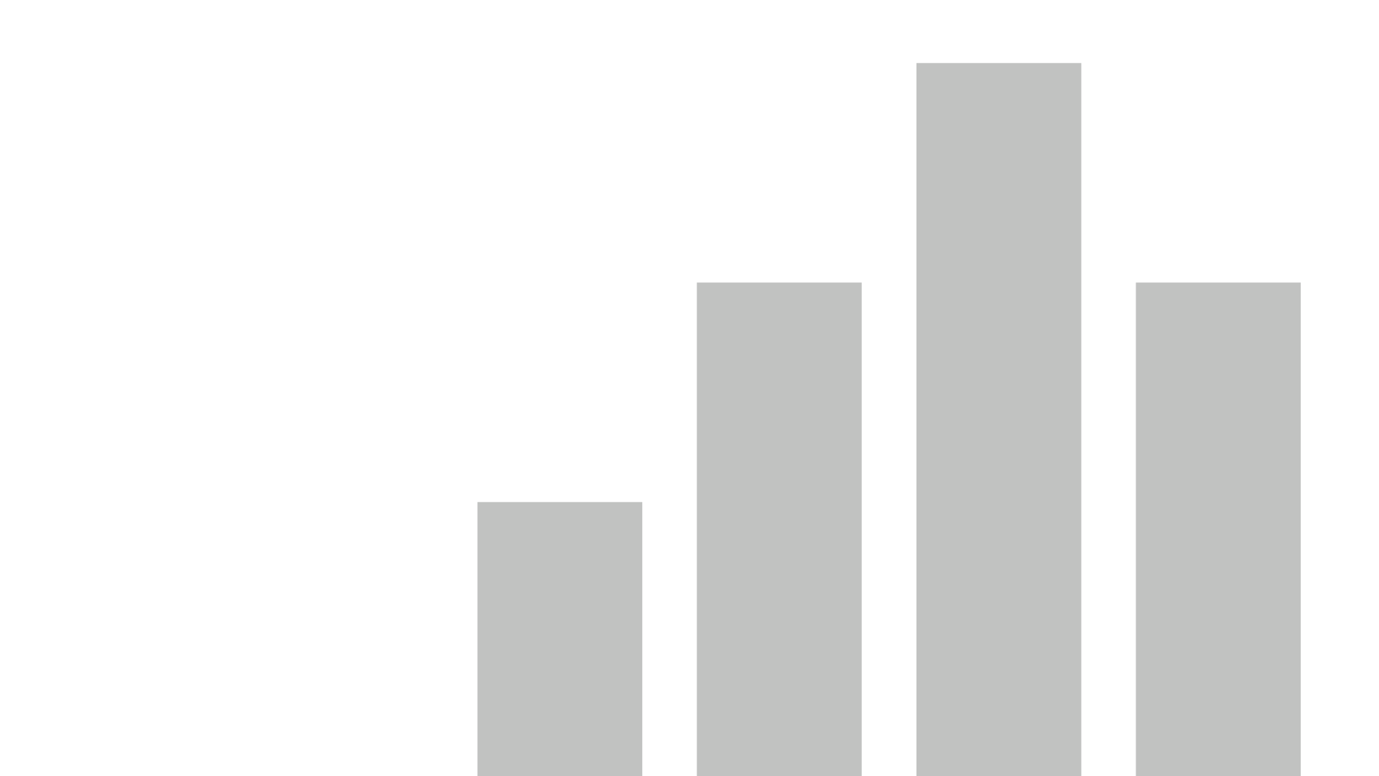


Water Quality Analysis
View in Power BI
Last data refresh:
2/19/2025 7:57:23 PM UTC
Downloaded at:
2/20/2025 11:46:44 AM UTC

Slide 2
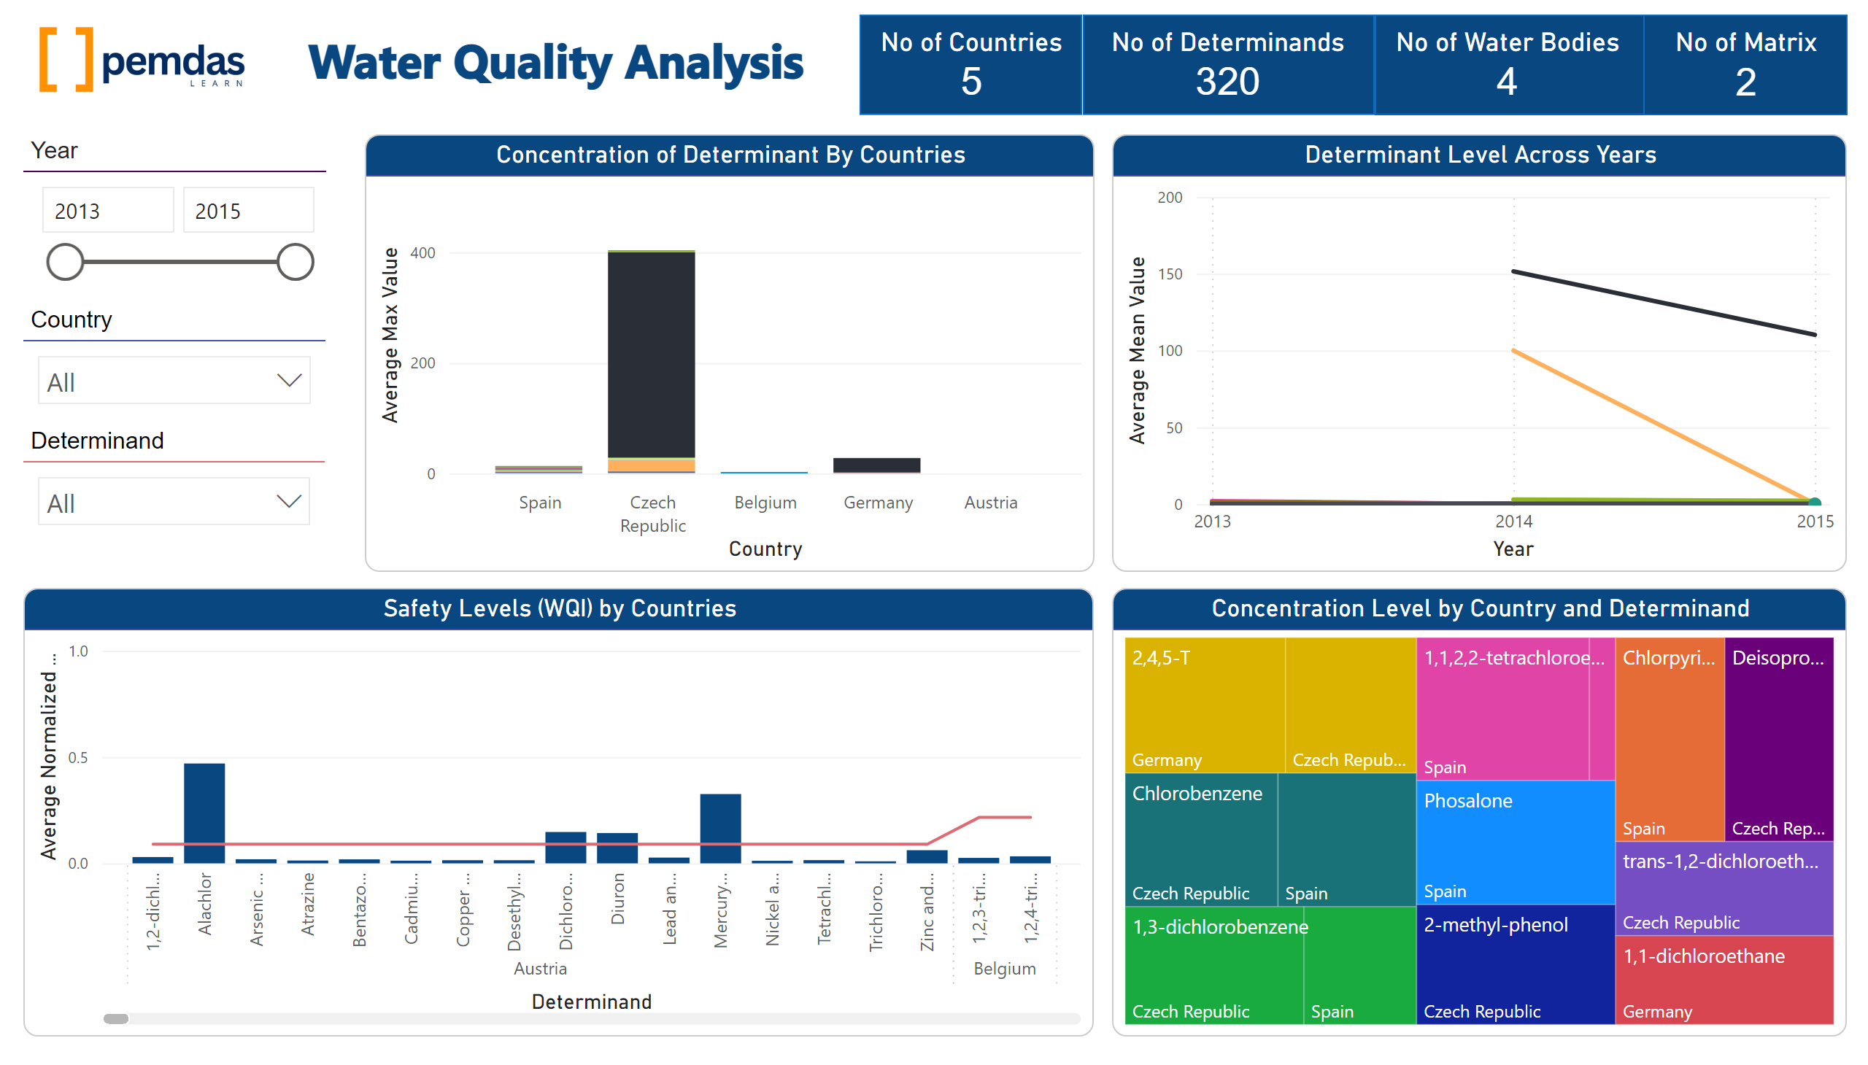
Page 1
Notes:
Determinant Level Across Years
No alt text provided
Safety Levels (WQI) by Countries
No alt text provided
Concentration Level by Country and Determinand
No alt text provided
image
No alt text provided
Concentration of Determinant By Countries
No alt text provided
Year
No alt text provided
Determinand
No alt text provided
Country
No alt text provided
shape
No alt text provided
No of Matrix
No alt text provided
shape
No alt text provided
No of Water Bodies
No alt text provided
shape
No alt text provided
No of Determinands
No alt text provided
shape
No alt text provided
No of Countries
No alt text provided
textbox
No alt text provided

Slide 3
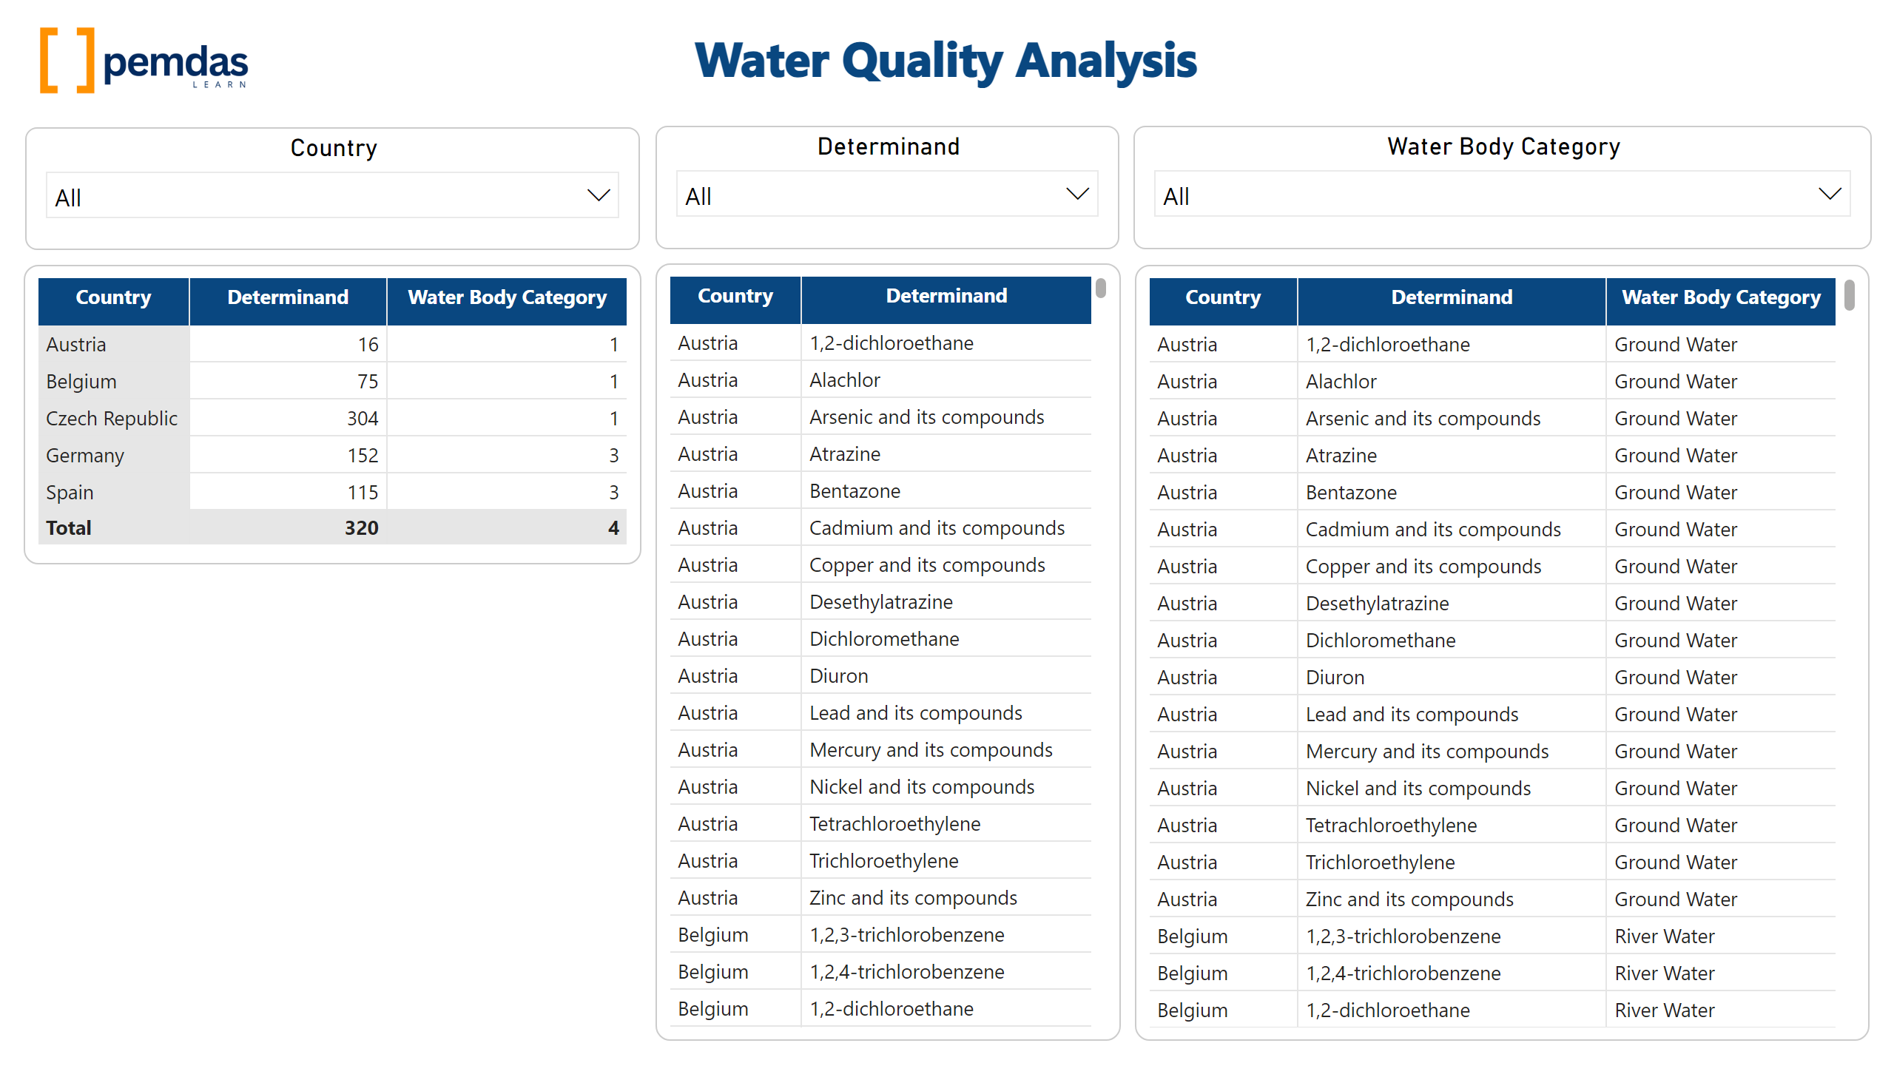
Page 2
Notes:
Country
No alt text provided
Determinand
No alt text provided
Water Body Category
No alt text provided
tableEx
No alt text provided
tableEx
No alt text provided
tableEx
No alt text provided
textbox
No alt text provided
image
No alt text provided

